Slide 1

AIR BNB DATA ANALYSIS
By Dr.Shaik Muhammed Junaid

Slide 2
INTRODUCTION
ANLYSIS
PROBLEMS
TAKEAWAYS

Slide 3
INTRODUCTION
OBJECTIVE OF THIS ANALYSIS
To contribute to the success of AIR BNB business by utilizing data analysis techniques, and to provide valuable insights and accurate visuals.

Slide 4
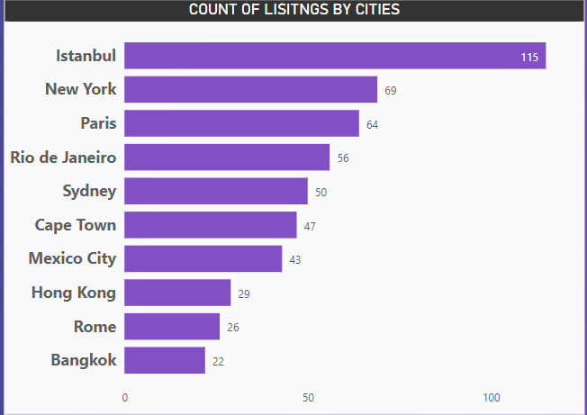
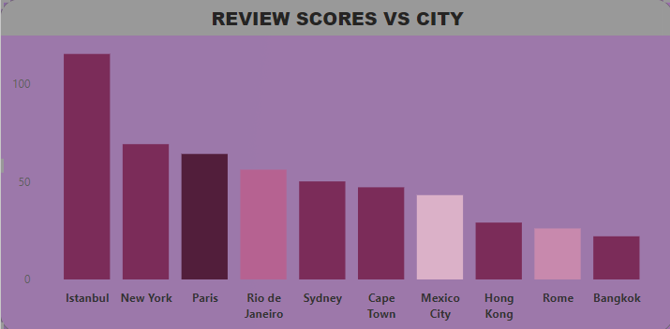
ANALYSIS
ABOUT THE GIVEN DATA:
This data is about the AIR BNB listings of 10 cities
Out of which ISTANBUL has the highest number of listings
Like wise the city with highest review scores is ISTANBUL

Slide 5
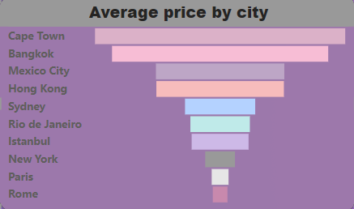
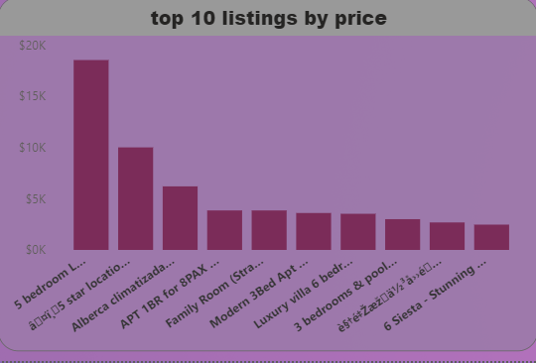
CAPE TOWN is the city with the highest average price for its listings.
And ROME,PARIS are one of the lowest average priced cities in terms of listings, may be due to this, these two cities are so famous and are always bussing with tourists.
Here is a list of top ten highest priced listings out of all cities.

Slide 6
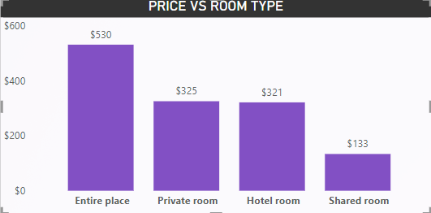
This visual shows us the average price by room type, and with this AIR BNB can keep its customers informed about the prices and help them take a informed decision.

Slide 7
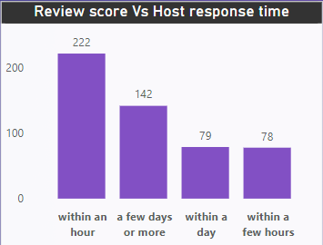
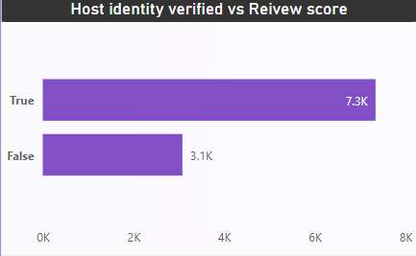
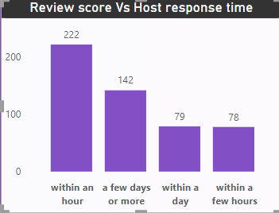
Lets look at how important is the relation between a HOST and a GUEST
From the above images it is clear that there should an honest, trustful relation between a host and its guest
Hence, AIR BNB as a business entity should always encourage its hosts to have verified profile pic and other security features must be added on the website so that the guests can take a confident decision.
And the hosts must be encouraged to always respond to its guest’s questions or queries in “as early as possible” fashion

Slide 8
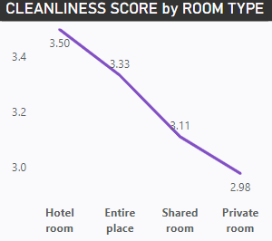
This graph shows us that in terms of cleanliness and hygiene hotel rooms are performing top class and private rooms are performing worst,
Hence there should a proper hygiene control protocol in place which can allow the guests to enjoy their stay by not worrying about the diseases they might carry to their home towns.

Slide 9
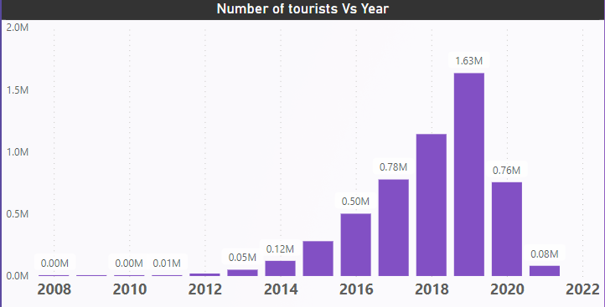
Let us understand the dynamics before and after pandemic
If we carefully analyze this visual, we can clearly witness the upward growth in number of tourists every year starting from 2012 to 2020.
After 2020, when pandemic hit, due to global lockdown, there was no movement in the world.
Hence, we can observe very stark drop in the number of tourists travelling in 2021.
To counter this:
The hosts must be encouraged to lower their prices.
There should a proper safety, hygienic, health protocol in place that the hosts can follow to make sure the guests who come to stay can leave a positive review and which in turn invites more guests.

Slide 10
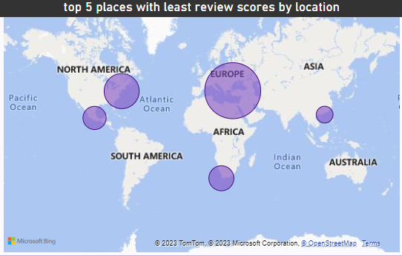
These bubbles on the word map, indicate the places with least review scores based on location, hence the need to beautify and make these places aesthetically more appealing is very much needed.

Slide 11
For interactive visuals and more detailed analysis about each visual kindly refer to the dashboard present in the powerbi file which is attached with this power point.
THANK YOU

